Slide 1
Book Chapter Summarization
Urhum Sheikh, Stuart Harley
Notes:
Hi everybody, we will be presenting about our Book Chapter Summarization project, my name is Urhum and my partner is Stuart.

Slide 2

Introduction
School HW assignments ask us to summarize chapters
People cheat and find summaries online
Goal: Create a system that would generate novel summaries so they wouldn’t be flagged for plagiarism
Notes:
Often times we are assigned homework assignments where we expected to read a section of a book and then summarize it in our own words. However, many people often end up cheating and go to sites like SparkNotes.com where they can just find a summarized version of the section they were assigned. So, we came up with an idea where we wanted to use NLP to create a model that could summarize chapters of a book in a new way so it wouldn’t be flagged for plagiarism. The way our system is supposed to work is we take in a text file that contains the chapter of said book, and then outputs a summary of that chapter built using the more important sentences in the chapter

Slide 3

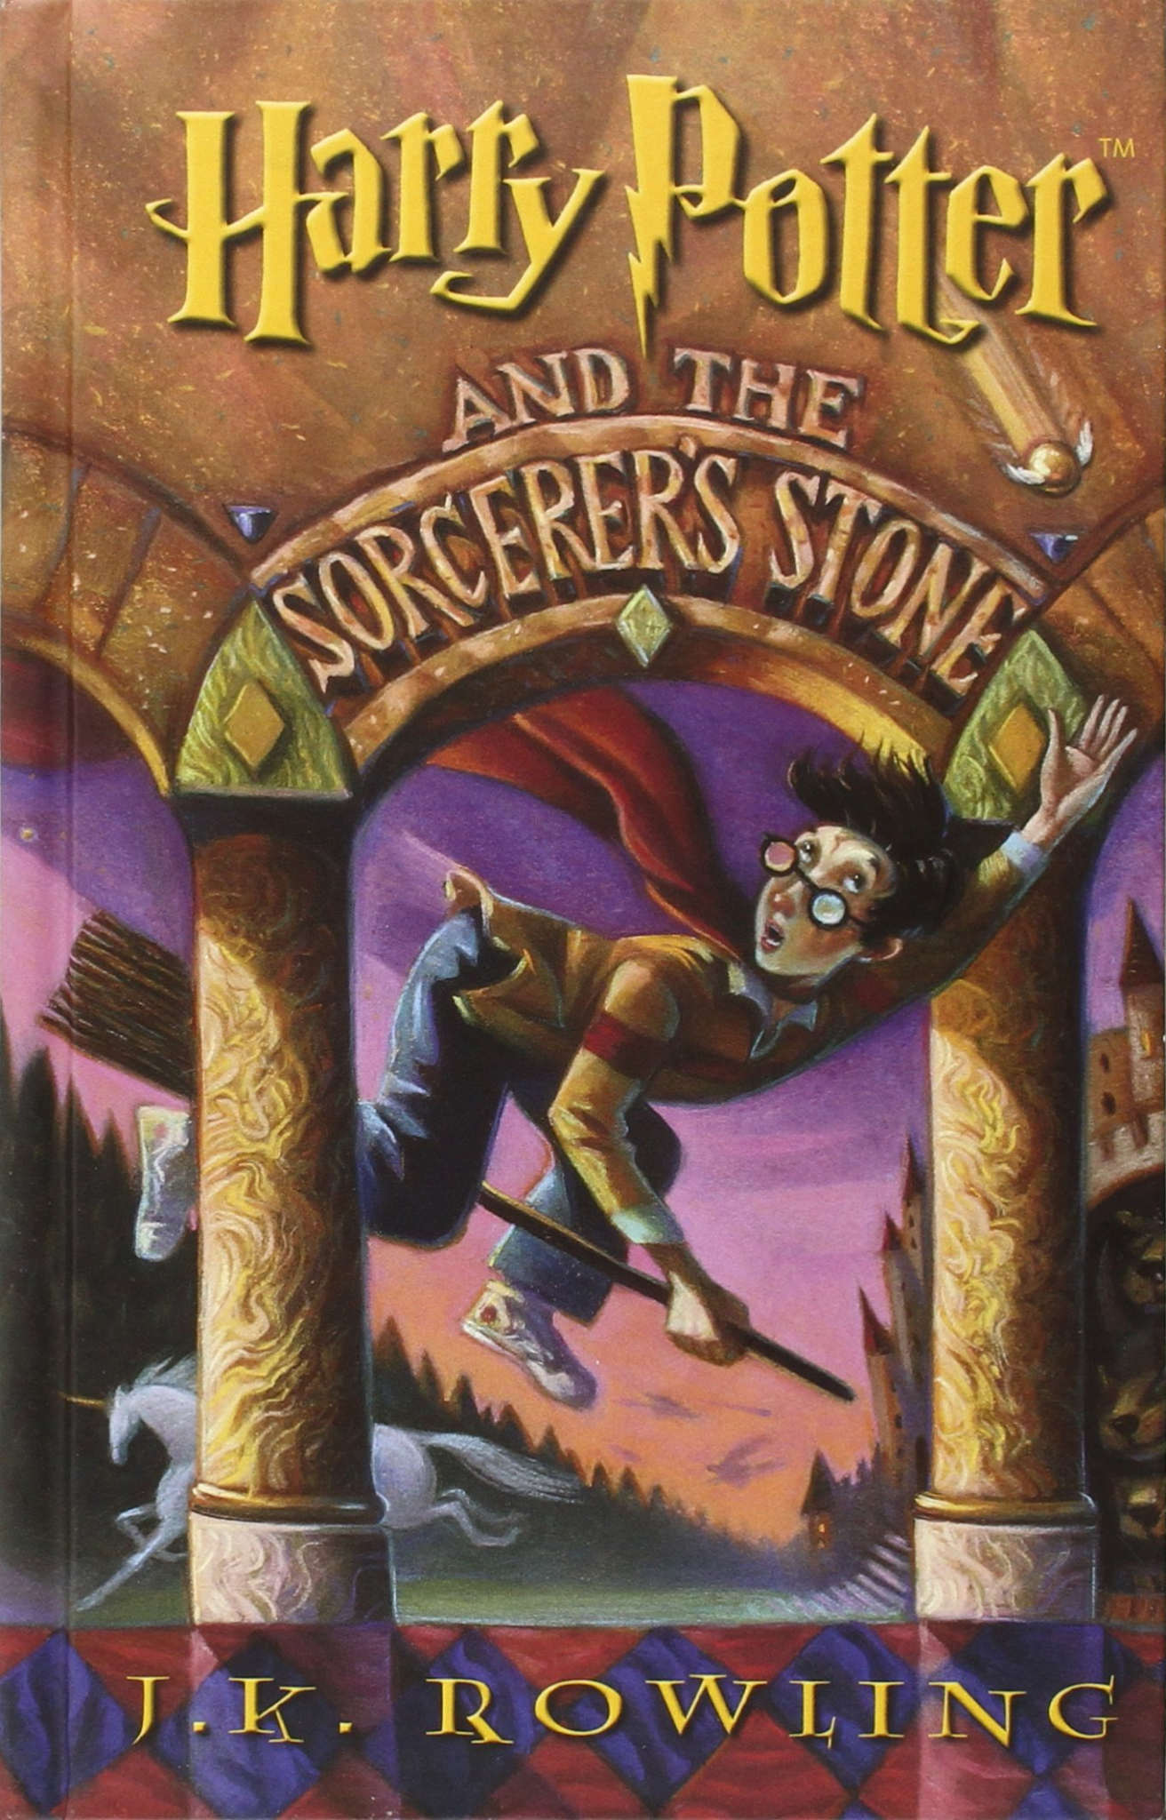
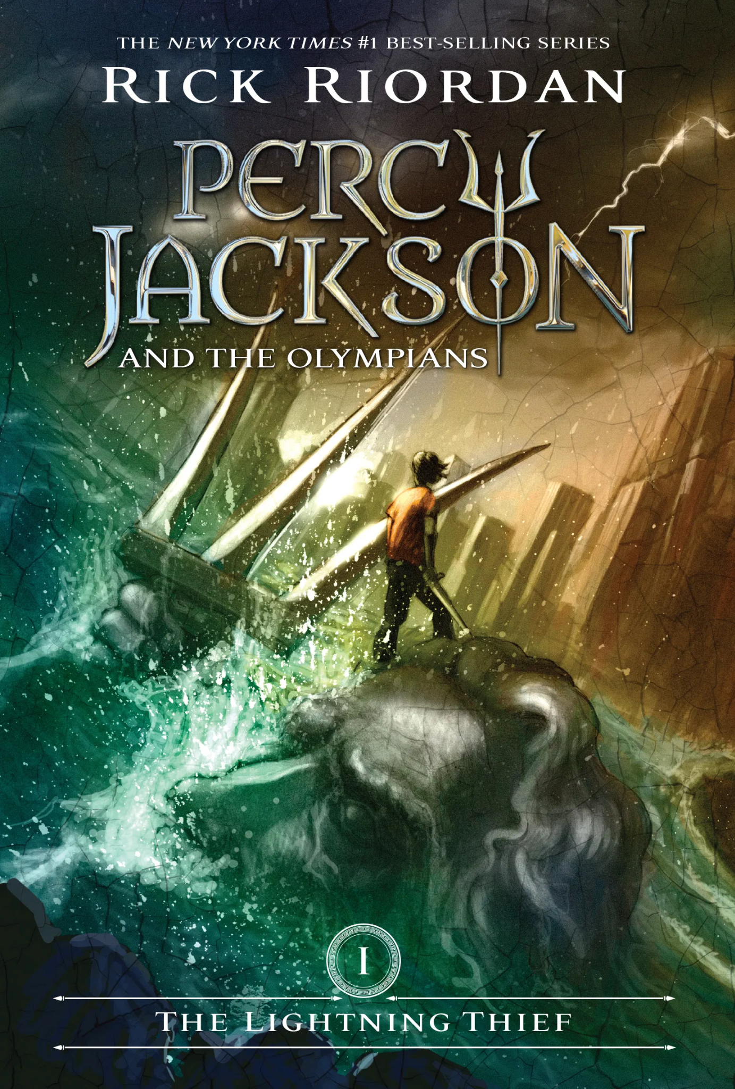
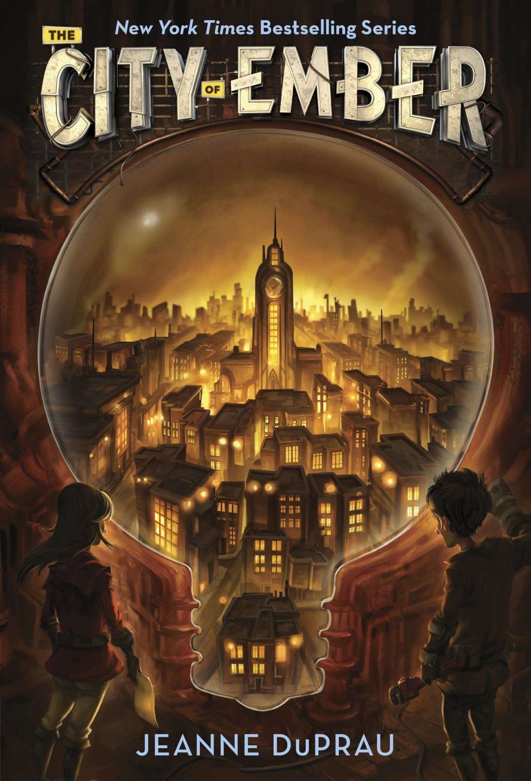
Data Collection
Chapter text from fiction novels:
The Hunger Games - Suzanne Collins
Harry Potter - J.K. Rowling
Percy Jackson - Rick Riordan
City of Ember - Jeanne DuPrau
Didn’t have to collect summaries to train the model on
Notes:
Chose famous books for easier access to pdf copies for chapters
Didn’t have to collect summaries because the method we chose didn’t require them for training

Slide 4
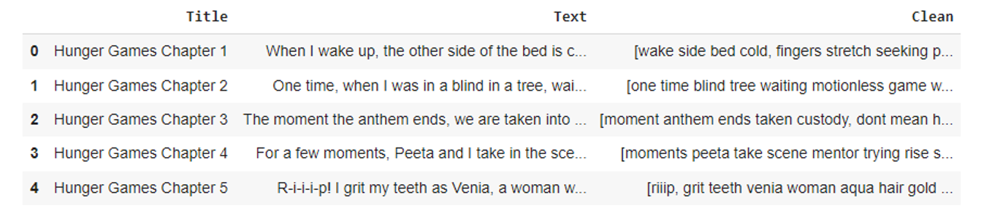
Data Cleaning & Preprocessing
Split chapters into sentences
Removing punctuation, numbers, and special characters
Converted text to lowercase
Removed stopwords
Notes:
Once we found the chapter text online we copied each chapter into 1 excel cell so the raw format of our data is pure text. We had to exclude a couple of chapters that were too long to fit into 1 cell, but our final system could theoretically use a chapter of any length.
Next we did some cleaning of the text data. First we split the chapter text into a list of sentences because our system relies on sentences. Next we removed any punctuation, numbers, and special characters from the text because they wouldn’t have any impact on the results. Next we converted all text to lower case to avoid word duplication. And finally we removed all stopwords from the text. Stopwords are words like “and” or “the” that don’t really contribute any meaning to the sentence. We removed these by checking a stopwords list from the natural language toolkit, which is basically just a long list of stopwords, and removing any matching stopwords in our text. At this point our data was ready to be used by our model.

Slide 5
System Architecture
Input
Read in chapter text
Cleaning
Normalize text, remove stopwords, split into sentences
Similarity Scores
Calculate sentence similarity using GloVe embeddings
PageRank
Rank the sentences by importance
Output
Print out the top sentences; Our summary
Notes:
This slide shows our system architecture. We’ve already gone over the first 2 steps and so now our cleaned data is ready to be used by our model. So first we took our cleaned sentences and turned them into a unique number vectors with values based on the words in the sentences. We did this using a large pregenerated list of word number values called GloVe embeddings.
So at this point all of our sentences were represented by numbers. Because of this we are able to now compare our sentences using these vectors to mathematically see how similar different sentences are to each other. So next we do this for every combination of sentences until we have a large matrix of similarity scores. So the values of this matrix represent how similar each sentence is to every other sentence.
Then we pass these similarities into the page rank algorithm. Simply, this algorithm looks at the similarities of all the sentences and ranks the sentences from most to least important. It does this basically by picking sentences that are least similar to the other top sentences so there is little similarity between top ranked sentences. Then the idea is that all unique information is presented without being repeated. Once we have these sentence rankings, we simply output the top ranked sentences.

Slide 6
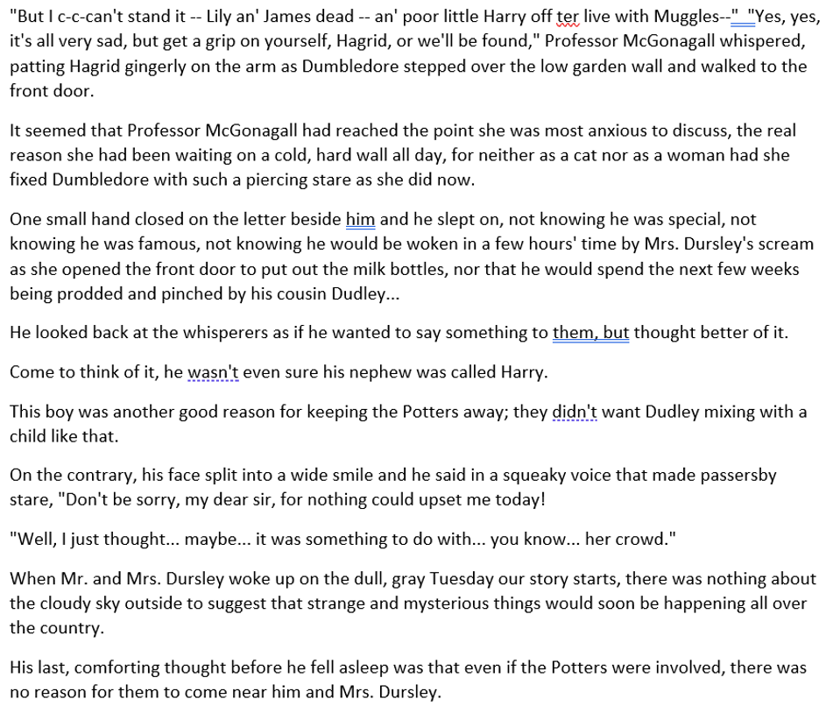
Results
System Generated Summary
Human Written Summary
The story starts off by describing the Dursley family. This family took pride in being as normal as possible. Mr. Dursley soon started to notice some peculiar events; the first event being a cat reading a map. Mr. Dursley assumed it to be a trick of the light, and continued on his normal way to work. At work he noticed many people wearing cloaks. Mr. Dursley didn’t think much of it, until he heard them murmur about his sister-in-law’s family, the Potters. Many other strange events took place that night, such as owls flying about during the day, and many shooting stars. The story then skips to a man named Albus Dumbledore on the Dursley’s street. The same cat Mr. Dursley noticed morphed into a woman by the name of Professor Mcgonagall. The two talk about how a seemingly evil you-know-who, or Voldemort, has gone away for good. They also talk about how he killed Harry Potter’s parents, Lily and James, but he failed to kill the little boy Harry. Then a man named Hagrid brings Harry, and leaves him with his only living family… The Dursley’s.
Notes:
From start to finish, our system is able to generate a summary in about 25-30 seconds, depending on the length of the chapter. Here we have the system generated summary of the first chapter of harry potter and the sorcerers stone, and a human written summary we found online. We can compare these summaries visually to see how well our system did.
As you can see, our summary is created by picking sentences from the chapter that the algorithm ranked as most important. However, because these sentences are from a chapter, which occurs in a sequence, the sentences in our summary end up out of order, which can be confusing. However, the more glaring issue is that the sentences do not fit together nicely to form an understandable summary. If you’re familiar with Harry Potter you can see that some important information is present, like you can see that James and Lilly die in the first sentence, but if not were not familiar with the book you would have a tough time understanding what is going on. Whereas, we can see in the human written summary, this is much more what we would expect to see in a summary. A cohesive paragraph that talks about the important things that happened in the chapter.

Slide 7
Lessons Learned
PageRank algorithm poor for this project
Out of order information based on importance
Doesn’t make sense
Better suited for highlighting important information in smaller articles
A different summarization model would likely yield better results
Notes:
In conclusion we used the wrong type of model for this task. Since our model only selects sentences that exist in the chapter to form our summary, it ends up being confusing and not very meaningful. This is because there is just too much text in any given chapter. And much of it is dialogue or unimportant information that isn’t relevant to a summary. And because of the way the page rank algorithm works, some of this is bound to end up in our summary. We believe that this sort of model would be more useful for summarizing relatively small articles where sentence sequence is not as important. Also existing sentences in the article would be more informational, so they would fit into a summary better.
If we were to try this again, we would have gone with a different type of algorithm. Instead of the pagerank algorithm which picks existing sentences, we believe an abstractive summarization model would work better. This type of model generates entirely new sentences instead of just being limited to existing sentences, and we believe this approach would have been better able to summarize book chapters.

